Slide 1

Noida Institute of Engineering and Technology, Greater Noida
Non-Linear Programming
Unit: III
Subject Name
Optimization & Numerical Techniques(AAS0404)
Dr. Anil Agarwal
Mathematics Department
Course Details B Tech-4th Sem.

Slide 2

Noida Institute of Engineering and Technology, Greater Noida
Brief Introduction
Name: Dr. Anil Agarwal
Qualification: M.Sc. , (Agra University), Ph.D. (Dr. B. R. A. University)
Total Exp: 22+ Yrs
Course Taught: Maths-I, Maths-II, Maths-III, S & P, Operation Research etc.

Slide 3
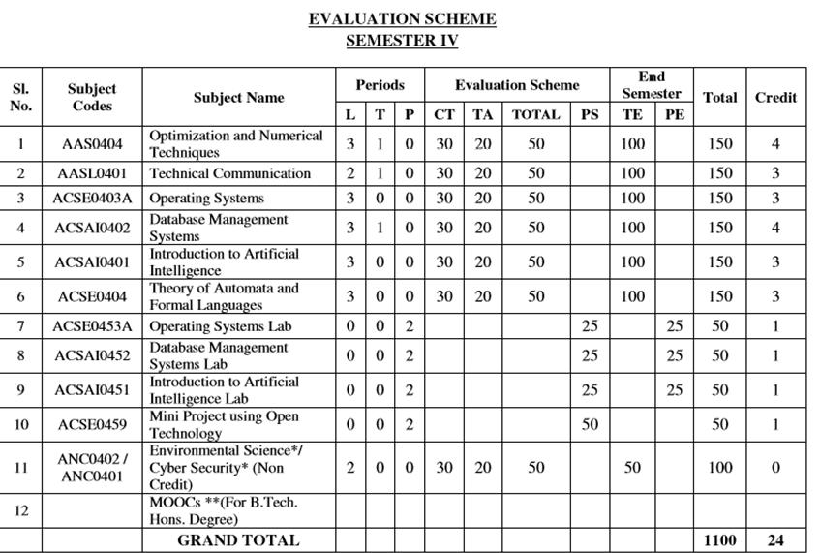
Evaluation Scheme

Slide 4
Syllabus
UNIT-I | Linear Programming | 8
Introduction, Mathematical formulation of LP Models, Graphical Method, Description of simplex method, Big-M method, Two phase method , Alternative optimum solutions, unbounded solutions, Degeneracy , Duality in LPP.
UNIT-II | Integer Programming | 8
Introduction, Importance of Integer Programming Problems, Gomory’s Cutting Plane method, Branch-and-Bound Method, Cargo Loading for Knapsack problem , Applications of Integer Programming.
UNIT-III | Non-linear programming | 8
Basic facts of maxima, minima & convex optimization, Convex sets and convex functions, Continuity and differentiable properties of convex functions, Constrained Optimization- Local and Global Solution Introduction, Elements of Constraint Programming, Lagrange multiplier method, Kuhn Tucker Condition.
UNIT-IV | Numerical Techniques | 10
Errors analysis, Zeroes of transcendental and polynomial equations using Bisection method, Regula-falsi method and Newton-Raphson method, Interpolation: Finite differences, Newton’s forward and backward interpolation, Lagrange’s and Newton’s divided difference formula for unequal intervals. Solution of system of linear equations, Crout’s method, Gauss- Seidel method. Numerical integration, Trapezoidal rule, Simpson’s one third and three-eight rules, Solution of first order ordinary differential equations by fourth-order Runge- Kutta methods.
UNIT-V | Aptitude-IV | 8
Number System, Permutation & Combination, Probability, Function, Data Interpretation,. Syllogism

Slide 5
Branchwise Application of NLPP(CO3)
Data networks-Routing
Production planning
Resource allocation
Computer-aided design
Solution of equilibrium models
Data analysis and least squares formulations
Modeling human or organizational behavior

Slide 6
Course Objective
The objective of this course is to familiarize the engineers with concept of Linear , Integer, Non-Linear Programming , Numerical Techniques & their applications. It aims to show case the students with standard concepts and tools from B. Tech to deal with advanced level of mathematics and applications that would be essential for their disciplines. The students will learn:
The idea of Linear Objective function and Linear programming.
The idea of concepts of Integer Programming.
The idea of concepts of Non-Linear Programming.
The concept of Numerical Techniques.
The concept of problems based on Number System, Permutation & Combination, Probability, Data Interpretation, Syllogism.

Slide 7
Course Outcome
CO1: Apply the working methods of Linear Programming .
CO2: Apply the concepts of Integer Programming and its uses.
CO3: Apply the concept of Non-Linear Programming.
CO4: Apply the concept of Numerical Techniques.
CO5: Solve the problems of Number System, Permutation & Combination, Probability, Function, Data Interpretation and Syllogism.

Slide 8
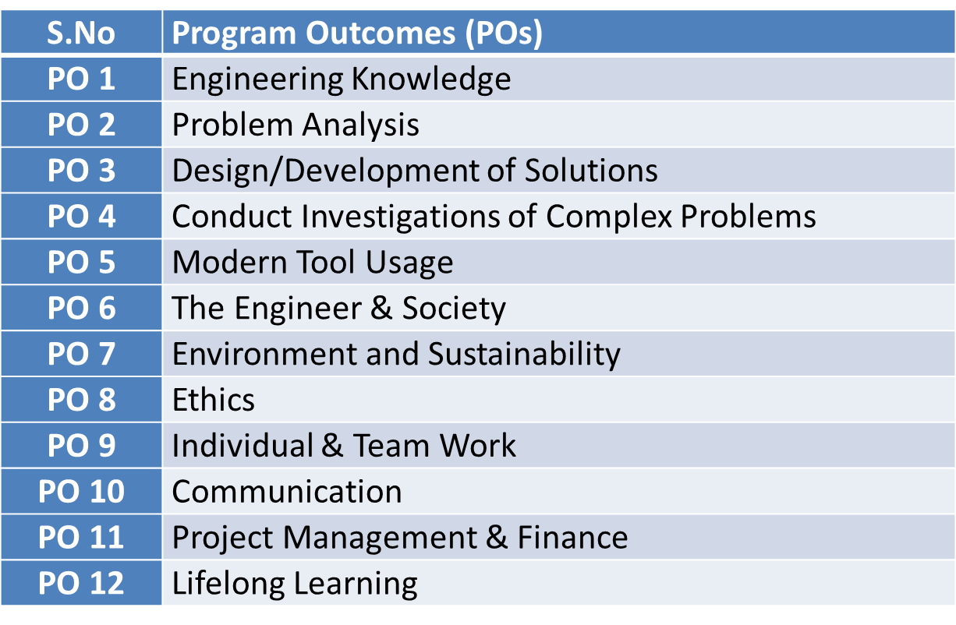
Program Outcomes

Slide 9
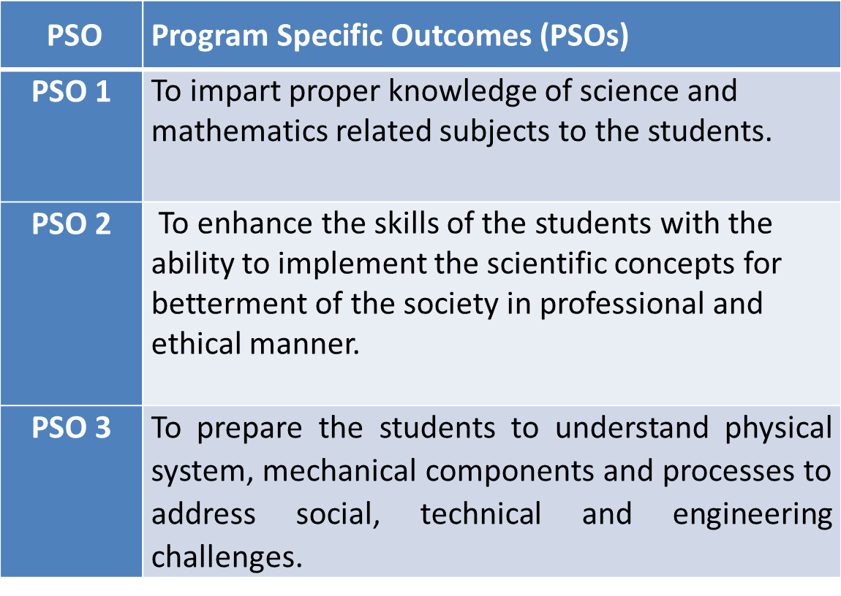
PSO

Slide 10
CO-PO Mapping(CO3)
Sr. No | Course Outcome | PO1 | PO2 | PO3 | PO4 | PO5 | PO6 | PO7 | PO8 | PO9 | PO10 | PO11 | PO12
1 | CO 1 | H | H | H | H | L | L | L | L | L | L | L | M
2 | CO 2 | H | H | H | H | L | L | L | L | L | L | M | M
3 | CO 3 | H | H | H | H | L | L | L | L | L | L | M | M
4 | CO 4 | H | H | H | H | L | L | L | L | L | L | L | M
5 | CO 5 | H | H | H | H | L | L | L | L | L | L | M | M
*L= Low *M= Medium *H= High

Slide 11
CO-PSO Mapping(CO3)
*L= Low *M= Medium *H= High
CO | PSO 1 | PSO 2 | PSO 3
CO.1 | H | L | M
CO.2 | L | M | L
CO.3 | M | M | M
CO.4 | H | M | M
CO.5 | H | M | M

Slide 12

Program Educational Objectives(PEOs)
PEO-1: To have an excellent scientific and engineering breadth so as to comprehend, analyze, design and provide sustainable solutions for real-life problems using state-of-the-art technologies.
PEO-2: To have a successful career in industries, to pursue higher studies or to support entrepreneurial endeavors and to face the global challenges.
PEO-3: To have an effective communication skills, professional attitude, ethical values and a desire to learn specific knowledge in emerging trends, technologies for research, innovation and product development and contribution to society.
PEO-4: To have life-long learning for up-skilling and re-skilling for successful professional career as engineer, scientist, entrepreneur and bureaucrat for betterment of society.

Slide 13
Unit Contents(CO3)
Introduction of Non-Linear Programming.
Convex and concave sets, Convex and Concave functions.
Formulate the Non-Linear Programming Problems.
Constraints Problems of Maxima & Minima using Lagrange Multiplier Method.
Constraints Problems of Maxima & Minima using Kuhn- Tucker Method.

Slide 14
Unit Objective(CO3)
The objective of this course is to familiarize the engineers with concept of Non-Linear Programming Problems. It aims to show case the students with standard concepts and tools from B. Tech to deal with advanced level of Optimization Techniques and applications that would be essential for their disciplines .

Slide 15
Prerequisite and Recap(CO3)
Knowledge of Mathematics- I of B.Tech
Knowledge of Mathematics- II of B.Tech
Knowledge of inequalities.
Knowledge of Linear Programming Problems.

Slide 16
Topic Objective (CO3)
Non-Linear Programming:
Introduction of Non-linear Programming problems. So that the Students understand that “ What is non-linear programming”.
Convex Set and Convex function.
Convex Set and Concave functions.
Formulate the NLPP.

Slide 17
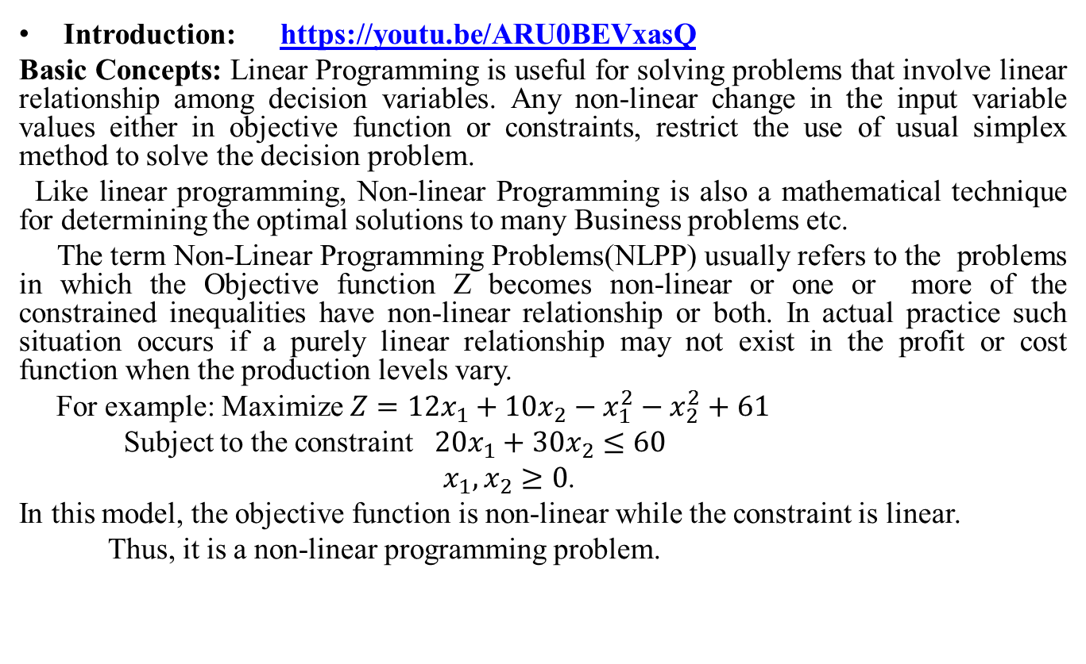
Non-Linear Programming Problems(CO3)
Introduction: https://youtu.be/ARU0BEVxasQ
Basic Concepts: Linear Programming is useful for solving problems that involve linear relationship among decision variables. Any non-linear change in the input variable values either in objective function or constraints, restrict the use of usual simplex method to solve the decision problem.
Like linear programming, Non-linear Programming is also a mathematical technique for determining the optimal solutions to many Business problems etc.
The term Non-Linear Programming Problems(NLPP) usually refers to the problems in which the Objective function Z becomes non-linear or one or more of the constrained inequalities have non-linear relationship or both. In actual practice such situation occurs if a purely linear relationship may not exist in the profit or cost function when the production levels vary.
For example: Maximize $Z=12x_{1}+10x_{2}−x_{1}^{2}−x_{2}^{2}+61$
Subject to the constraint $20x_{1}+30x_{2}≤60$
$x_{1},x_{2}≥0$.
In this model, the objective function is non-linear while the constraint is linear.
Thus, it is a non-linear programming problem.

Slide 18
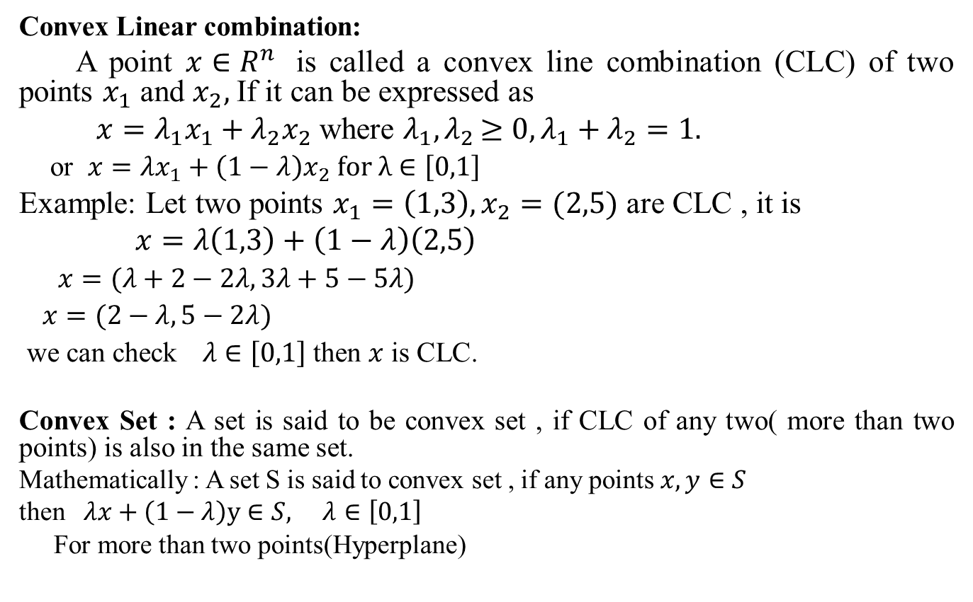
CLC, Convex Set, Convex function(CO3)
Convex Linear combination:
A point $x∈R^{n}$is called a convex line combination (CLC) of two points $x_{1}$ and $x_{2},$If it can be expressed as
$x=λ_{1}x_{1}+λ_{2}x_{2}$ where $λ_{1}{,λ}_{2}≥0, λ_{1}+λ_{2}=1.$
or $x=λx_{1}+\left(1−λ\right)x_{2} for λ∈\left[0,1\right]$
Example: Let two points $x_{1}=\left(1,3\right), x_{2}=(2,5)$ are CLC , it is
$x=λ\left(1,3\right)+\left(1−λ\right)\left(2,5\right)$
$x=(λ+2−2λ, 3λ+5−5λ)$
$x=(2−λ, 5−2λ)$
we can check$λ∈\left[0,1\right]$ then $x$ is CLC.
Convex Set : A set is said to be convex set , if CLC of any two( more than two points) is also in the same set.
Mathematically : A set S is said to convex set , if any points $x,y∈S$
then$λx+\left(1−λ\right)y∈S, λ∈\left[0,1\right]$
For more than two points(Hyperplane)

Slide 19
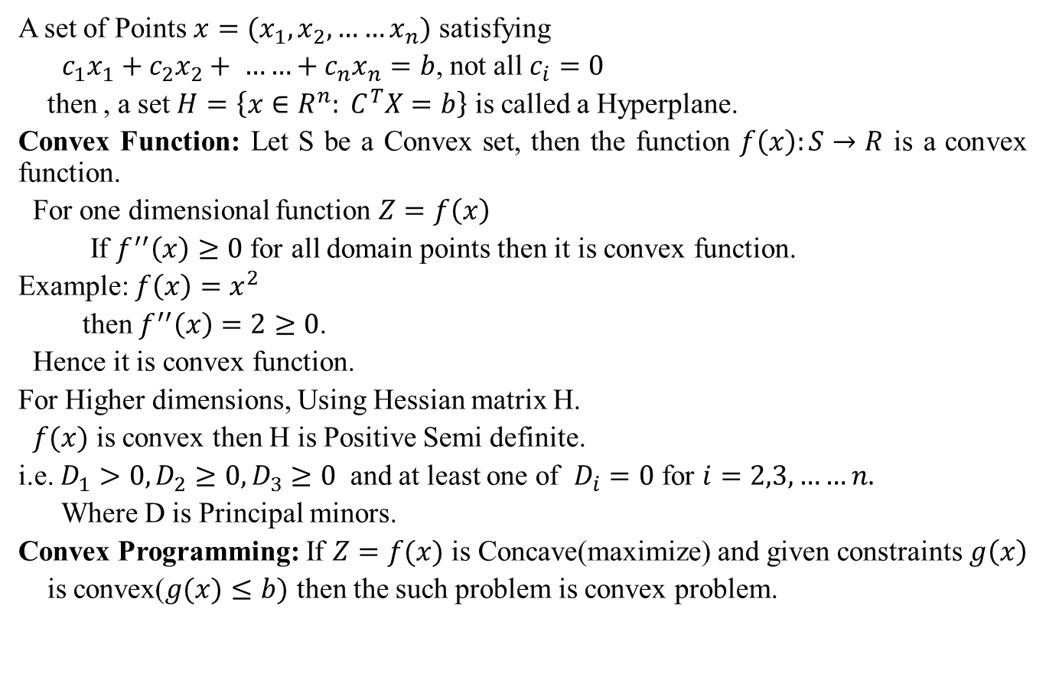
Convex Set, Convex Function(CO3)
A set of Points $x=(x_{1}, x_{2}, ……x_{n})$ satisfying
$c_{1}x_{1}+c_{2}x_{2}+ ……+c_{n}x_{n}=b$, not all $c_{i}=0$
then , a set $H=\left\{x∈R^{n}: C^{T}X=b\right\}$ is called a Hyperplane.
Convex Function: Let S be a Convex set, then the function $f\left(x\right):S→R$is a convex function.
For one dimensional function $Z=f\left(x\right)$
If $f^{′′}\left(x\right)≥0$ for all domain points then it is convex function.
Example: $f\left(x\right){=x}^{2}$
then $f^{′′}\left(x\right)=2≥0$.
Hence it is convex function.
For Higher dimensions, Using Hessian matrix H.
$f(x)$ is convex then H is Positive Semi definite.
i.e. $D_{1}>0,D_{2}≥0,D_{3}≥0$ and at least one of $D_{i}=0$ for $i=2,3,……n.$
Where D is Principal minors.
Convex Programming: If $Z=f(x)$is Concave(maximize) and given constraints$g\left(x\right)$
is convex($g(x)≤b)$ then the such problem is convex problem.

Slide 20
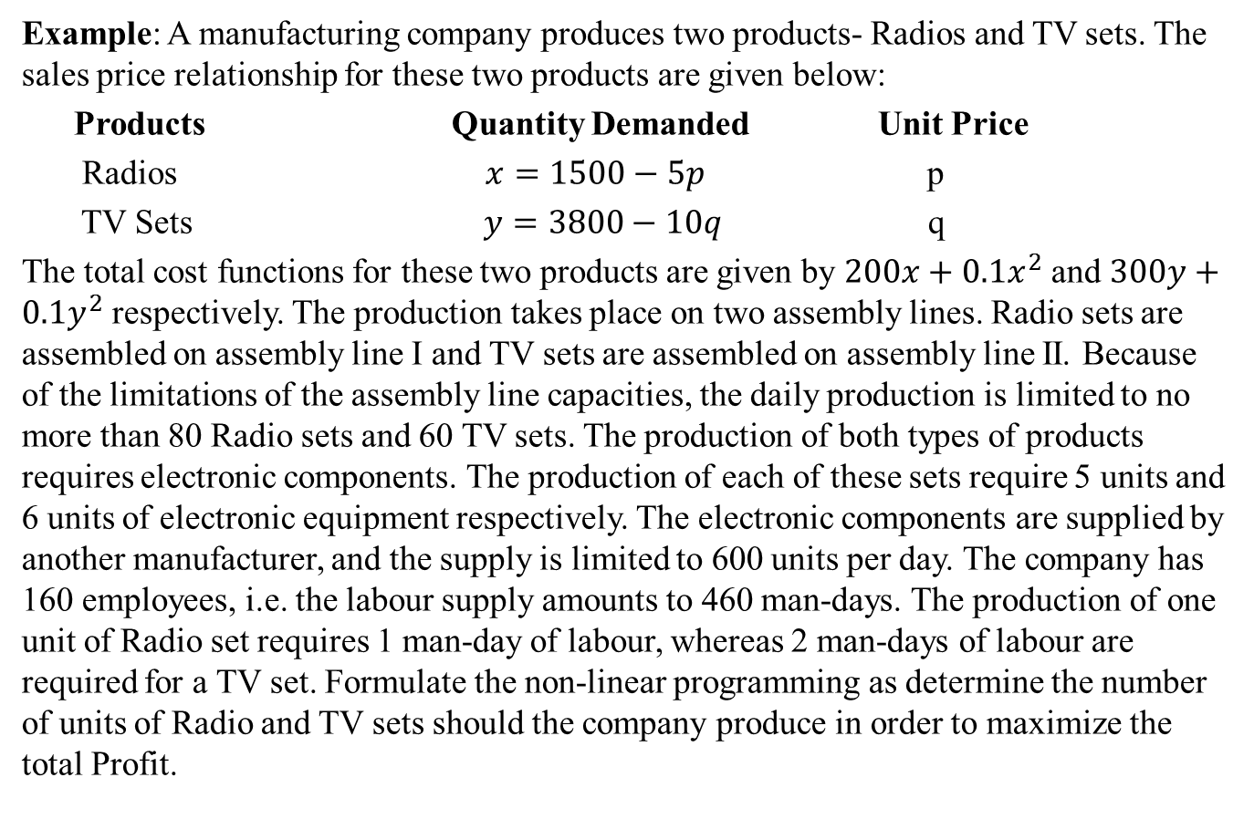
Formulation of Non-Linear Programming(CO3)
Example: A manufacturing company produces two products- Radios and TV sets. The sales price relationship for these two products are given below:
Products Quantity Demanded Unit Price
Radios $x=1500−5p$ p
TV Sets $y=3800−10q$ q
The total cost functions for these two products are given by $200x+0.1x^{2}$ and $300y+0.1y^{2}$ respectively. The production takes place on two assembly lines. Radio sets are assembled on assembly line I and TV sets are assembled on assembly line II. Because of the limitations of the assembly line capacities, the daily production is limited to no more than 80 Radio sets and 60 TV sets. The production of both types of products requires electronic components. The production of each of these sets require 5 units and 6 units of electronic equipment respectively. The electronic components are supplied by another manufacturer, and the supply is limited to 600 units per day. The company has 160 employees, i.e. the labour supply amounts to 460 man-days. The production of one unit of Radio set requires 1 man-day of labour, whereas 2 man-days of labour are required for a TV set. Formulate the non-linear programming as determine the number of units of Radio and TV sets should the company produce in order to maximize the total Profit.

Slide 21
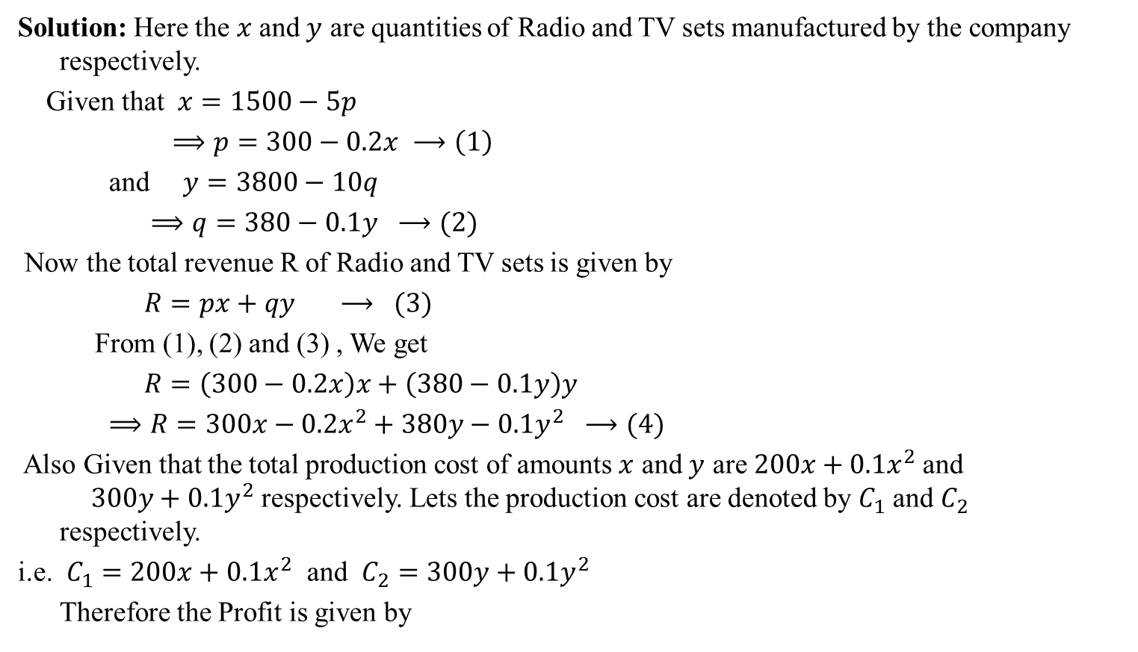
(Contd.)
Solution: Here the $x$and $y$ are quantities of Radio and TV sets manufactured by the company respectively.
Given that $x=1500−5p$
$⟹p=300−0.2x ⟶\left(1\right)$
and $y=3800−10q$
$⟹q=380−0.1y ⟶(2)$
Now the total revenue R of Radio and TV sets is given by
$R=px+qy ⟶ (3)$
From (1), (2) and (3) , We get
$R=\left(300−0.2x\right)x+\left(380−0.1y\right)y$
$⟹R=300x−0.2x^{2}+380y−0.1y^{2} ⟶(4)$
Also Given that the total production cost of amounts $x$ and $y$ are $200x+0.1x^{2}$and $300y+0.1y^{2}$ respectively. Lets the production cost are denoted by $C_{1}$ and $C_{2}$ respectively.
i.e. $C_{1}=200x+0.1x^{2}$ and $C_{2}=300y+0.1y^{2}$
Therefore the Profit is given by

Slide 22
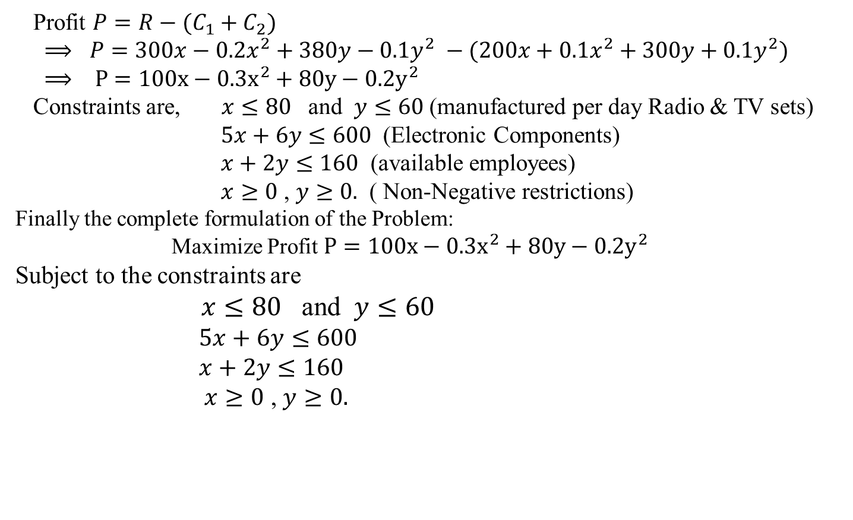
(Contd.)
Profit $P=R−(C_{1}+C_{2})$
$⟹ P=300x−0.2x^{2}+380y−0.1y^{2} −(200x+0.1x^{2}+300y+0.1y^{2})$
$⟹ P=100x−0.3x^{2}+80y−0.2y^{2}$
Constraints are, $x≤80$ and $y≤60$ (manufactured per day Radio & TV sets)
$5x+6y≤600$ (Electronic Components)
$x+2y≤160$ (available employees)
$x≥0$ , $y≥0.$ ( Non-Negative restrictions)
Finally the complete formulation of the Problem:
Maximize Profit $P=100x−0.3x^{2}+80y−0.2y^{2}$
Subject to the constraints are
$x≤80$ and $y≤60$
$5x+6y≤600$
$x+2y≤160$
$x≥0$ , $y≥0.$

Slide 23
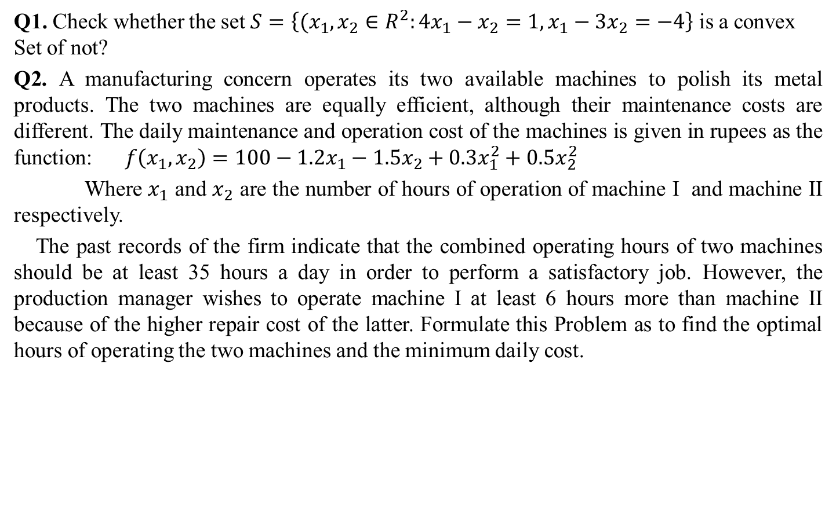
Daily Quiz
Q1. Check whether the set $S=\left\{(x_{1},x_{2}∈R^{2}:4x_{1}−x_{2}=1,x_{1}−3x_{2}=−4\right\}$is a convex Set of not?
Q2.A manufacturing concern operates its two available machines to polish its metal products. The two machines are equally efficient, although their maintenance costs are different. The daily maintenance and operation cost of the machines is given in rupees as the function: $f\left(x_{1}, x_{2}\right)=100−1.2x_{1}−1.5x_{2}+0.3x_{1}^{2}+0.5x_{2}^{2}$
Where $x_{1}$ and $x_{2}$ are the number of hours of operation of machine I and machine II respectively.
The past records of the firm indicate that the combined operating hours of two machines should be at least 35 hours a day in order to perform a satisfactory job. However, the production manager wishes to operate machine I at least 6 hours more than machine II because of the higher repair cost of the latter. Formulate this Problem as to find the optimal hours of operating the two machines and the minimum daily cost.

Slide 24
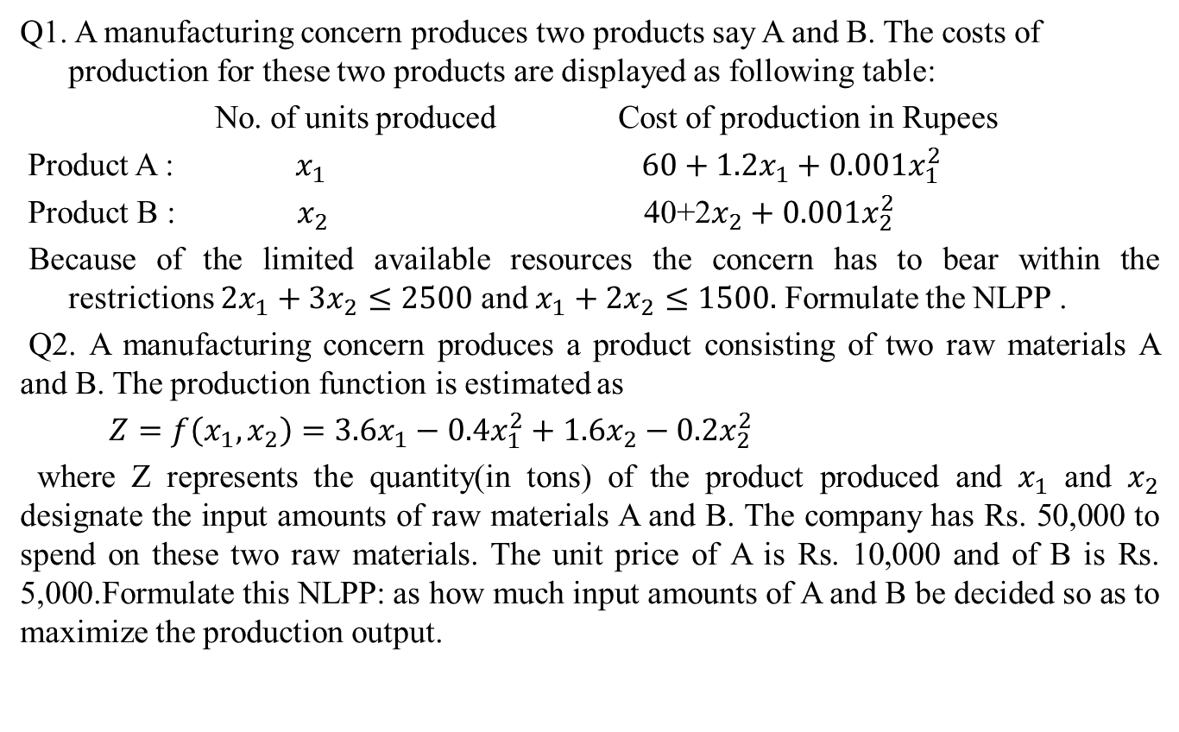
Weekly Assignment(CO3)
Q1. A manufacturing concern produces two products say A and B. The costs of production for these two products are displayed as following table:
No. of units produced Cost of production in Rupees
Product A : $x_{1}$$60+1.2x_{1}+0.001x_{1}^{2}$
Product B : $x_{2}$ 40+2$x_{2}+0.001x_{2}^{2}$
Because of the limited available resources the concern has to bear within the restrictions $2x_{1}+3x_{2}≤2500$ and $x_{1}+2x_{2}≤1500.$ Formulate the NLPP .
Q2. A manufacturing concern produces a product consisting of two raw materials A and B. The production function is estimated as
$Z=f\left(x_{1},x_{2}\right)=3.6x_{1}−0.4x_{1}^{2}+1.6x_{2}−0.2x_{2}^{2}$
where Z represents the quantity(in tons) of the product produced and $x_{1}$ and $x_{2}$ designate the input amounts of raw materials A and B. The company has Rs. 50,000 to spend on these two raw materials. The unit price of A is Rs. 10,000 and of B is Rs. 5,000.Formulate this NLPP: as how much input amounts of A and B be decided so as to maximize the production output.

Slide 25
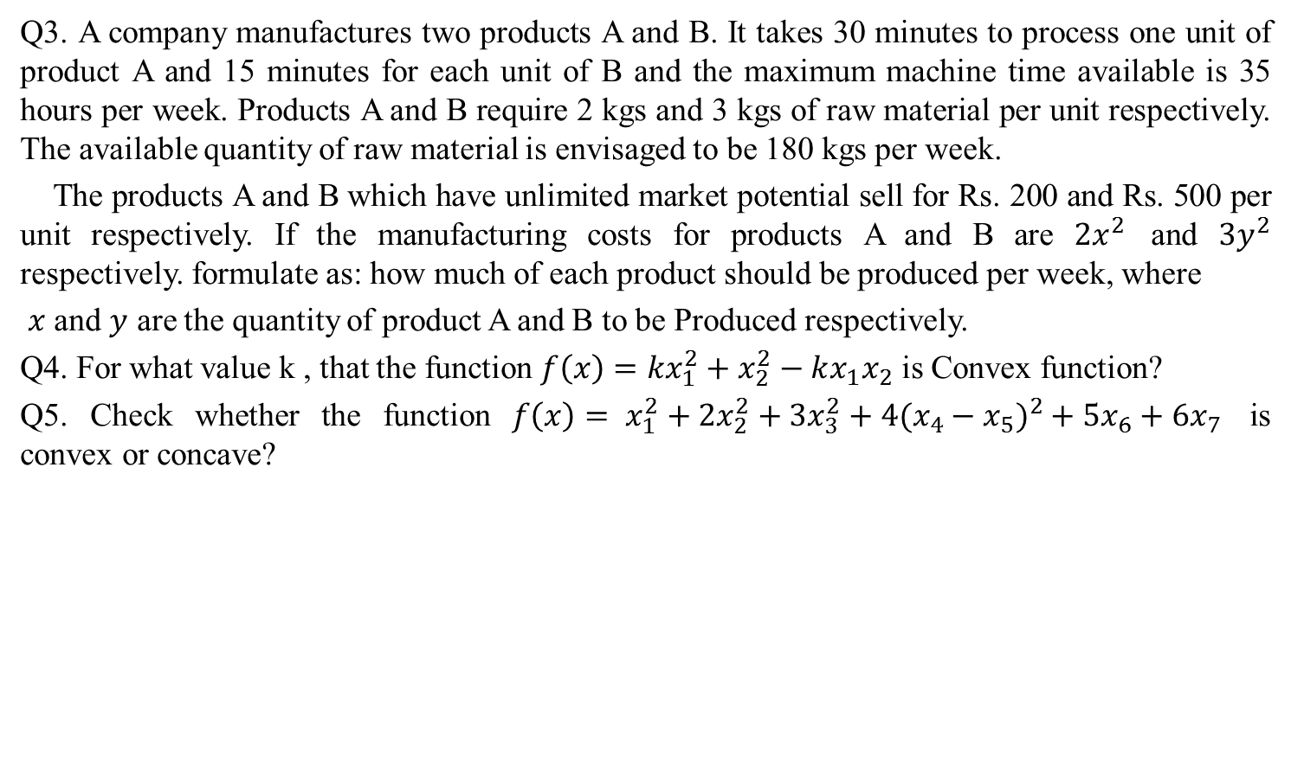
Weekly Assignment(CO3)
Q3. A company manufactures two products A and B. It takes 30 minutes to process one unit of product A and 15 minutes for each unit of B and the maximum machine time available is 35 hours per week. Products A and B require 2 kgs and 3 kgs of raw material per unit respectively. The available quantity of raw material is envisaged to be 180 kgs per week.
The products A and B which have unlimited market potential sell for Rs. 200 and Rs. 500 per unit respectively. If the manufacturing costs for products A and B are $2x^{2}$ and $3y^{2}$ respectively. formulate as: how much of each product should be produced per week, where
$x$and $y$ are the quantity of product A and B to be Produced respectively.
Q4. For what value k , that the function $f\left(x\right)={kx}_{1}^{2}+x_{2}^{2}−kx_{1}x_{2}$ is Convex function?
Q5. Check whether the function $f\left(x\right)= x_{1}^{2}+2x_{2}^{2}+3x_{3}^{2}+4({x_{4}−x_{5})}^{2}+5x_{6}+6x_{7}$ is convex or concave?

Slide 26
Prerequisite and Recap(CO3)
Knowledge of Mathematics-I of B.Tech.
Knowledge of Mathematics-II of B.Tech.
Knowledge of Maxima and Minima of a function of more than one variable.
Convex/ concave functions.

Slide 27
Topic Objective(CO3)
Constraints Problems of Maxima & Minima using Lagrange Multiplier Method:
In this Lecture , We shall discuss the problem of optimization of continuous function when the side conditions or constraints are placed on the variables. These constraints should be in the form of equations when we find the solution of the problem by using Lagrange multiplier method.

Slide 28
Constrained Problems of Maxima & Minima(CO3)
In this Lecture, we shall discuss with the problem of optimization of continuous functions when side conditions or constraints are placed on the variables. These constraints may be in the form of equations or inequalities.
We shall discuss first the case of equality constraints using Lagrangian Method and other case of inequality constraints using Kuhn- Tucker Method.

Slide 29

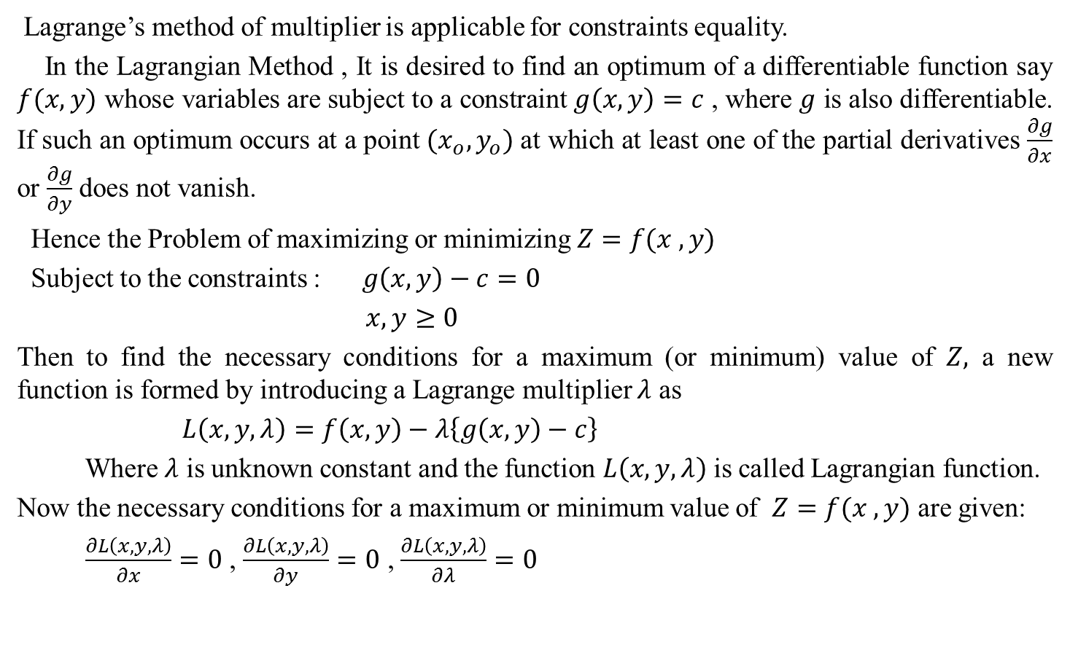
Lagrangian Method(CO3)
Lagrange’s method of multiplier is applicable for constraints equality.
In the Lagrangian Method , It is desired to find an optimum of a differentiable function say $f(x,y)$ whose variables are subject to a constraint $g\left(x,y\right)=c$ , where $g$ is also differentiable. If such an optimum occurs at a point $(x_{o}, y_{o})$ at which at least one of the partial derivatives $\frac{∂g}{∂x}$ or $\frac{∂g}{∂y}$ does not vanish.
Hence the Problem of maximizing or minimizing $Z=f(x , y)$
Subject to the constraints : $g\left(x,y\right)−c=0$
$x,y≥0$
Then to find the necessary conditions for a maximum (or minimum) value of $Z,$ a new function is formed by introducing a Lagrange multiplier $λ$ as
$L\left(x,y,λ\right)=f\left(x,y\right)−λ\left\{g\left(x,y\right)−c\right\}$
Where $λ$ is unknown constant and the function $L\left(x,y,λ\right)$ is called Lagrangian function.
Now the necessary conditions for a maximum or minimum value of $Z=f(x , y)$ are given:
$\frac{∂L\left(x,y,λ\right)}{∂x}=0$ , $\frac{∂L\left(x,y,λ\right)}{∂y}=0$, $\frac{∂L\left(x,y,λ\right)}{∂λ}=0$

Slide 30
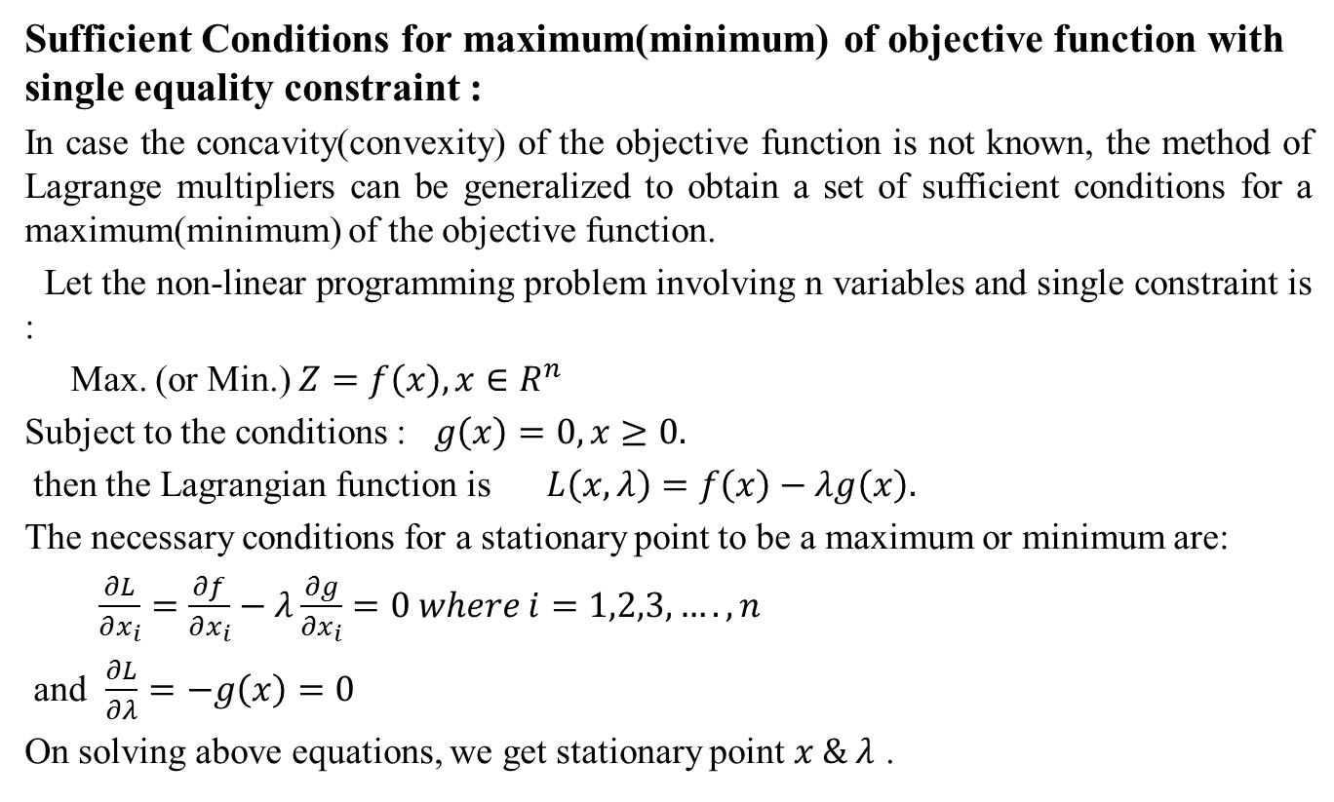
Lagrangian Method(CO3)
Sufficient Conditions for maximum(minimum) of objective function with single equality constraint :
In case the concavity(convexity) of the objective function is not known, the method of Lagrange multipliers can be generalized to obtain a set of sufficient conditions for a maximum(minimum) of the objective function.
Let the non-linear programming problem involving n variables and single constraint is :
Max. (or Min.) $Z=f\left(x\right), x∈R^{n}$
Subject to the conditions : $g\left(x\right)=0, x≥0.$
then the Lagrangian function is $L\left(x, λ\right)=f\left(x\right)−λg\left(x\right).$
The necessary conditions for a stationary point to be a maximum or minimum are:
$\frac{∂L}{∂x_{i}}=\frac{∂f}{∂x_{i}}−λ\frac{∂g}{∂x_{i}}=0 where i=1,2,3,….,n$
and $\frac{∂L}{∂λ}=−g\left(x\right)=0$
On solving above equations, we get stationary point $x \& λ$ .

Slide 31
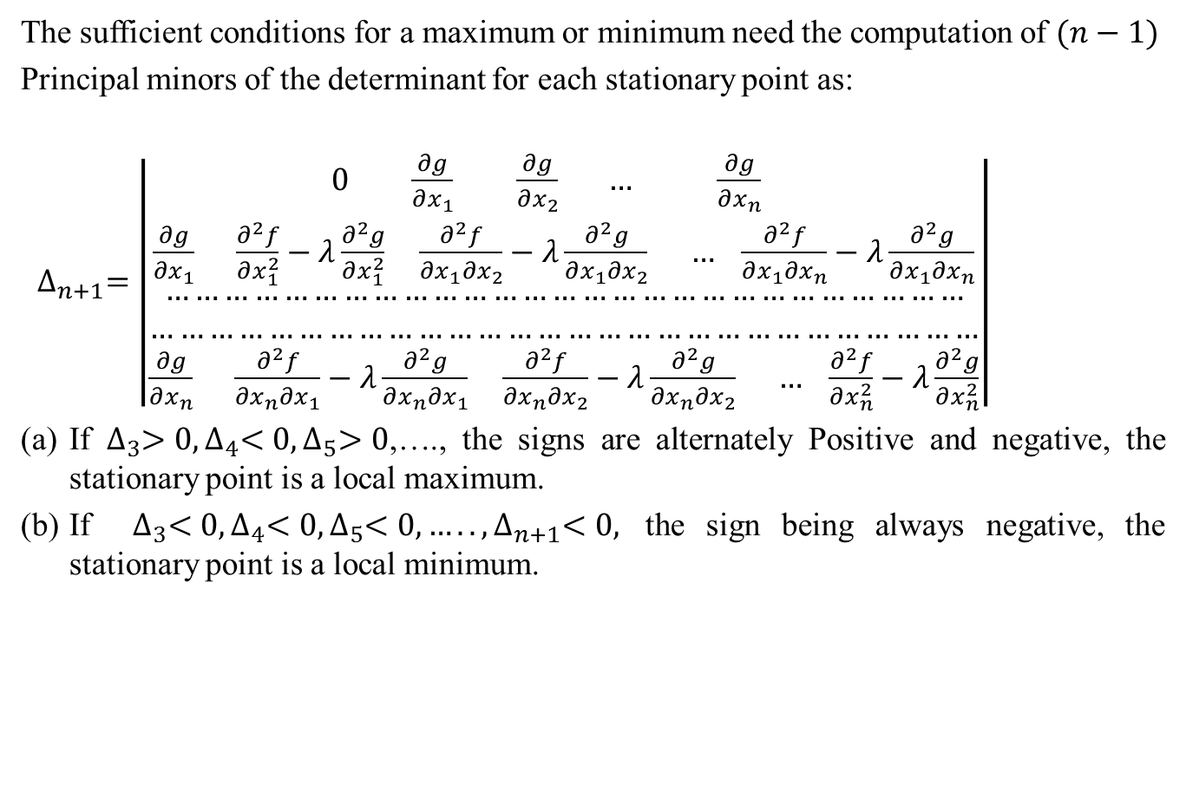
Lagrangian Method(CO3)
The sufficient conditions for a maximum or minimum need the computation of $(n−1)$
Principal minors of the determinant for each stationary point as:
$∆_{n+1}=\left|\begin{aligned}0 \frac{∂g}{∂x_{1}} \frac{∂g}{∂x_{2}} … \frac{∂g}{∂x_{n}} \\ \frac{∂g}{∂x_{1}} \frac{∂^{2}f}{∂x_{1}^{2}}−λ\frac{∂^{2}g}{∂x_{1}^{2}} \frac{∂^{2}f}{∂x_{1}∂x_{2}}−λ\frac{∂^{2}g}{∂x_{1}∂x_{2}} … \frac{∂^{2}f}{∂x_{1}∂x_{n}}−λ\frac{∂^{2}g}{∂x_{1}∂x_{n}} \\ ……………………………………………………………………… \\ ………………………………………………………………………… \\ \frac{∂g}{∂x_{n}} \frac{∂^{2}f}{∂x_{n}∂x_{1}}−λ\frac{∂^{2}g}{∂x_{n}∂x_{1}} \frac{∂^{2}f}{∂x_{n}∂x_{2}}−λ\frac{∂^{2}g}{∂x_{n}∂x_{2}} … \frac{∂^{2}f}{∂x_{n}^{2}}−λ\frac{∂^{2}g}{∂x_{n}^{2}}\end{aligned}\right|$
If $∆_{3}>0, ∆_{4}<0, ∆_{5}>0$,…., the signs are alternately Positive and negative, the stationary point is a local maximum.
If $∆_{3}<0, ∆_{4}<0,∆_{5}<0, ….., ∆_{n+1}<0,$ the sign being always negative, the stationary point is a local minimum.

Slide 32
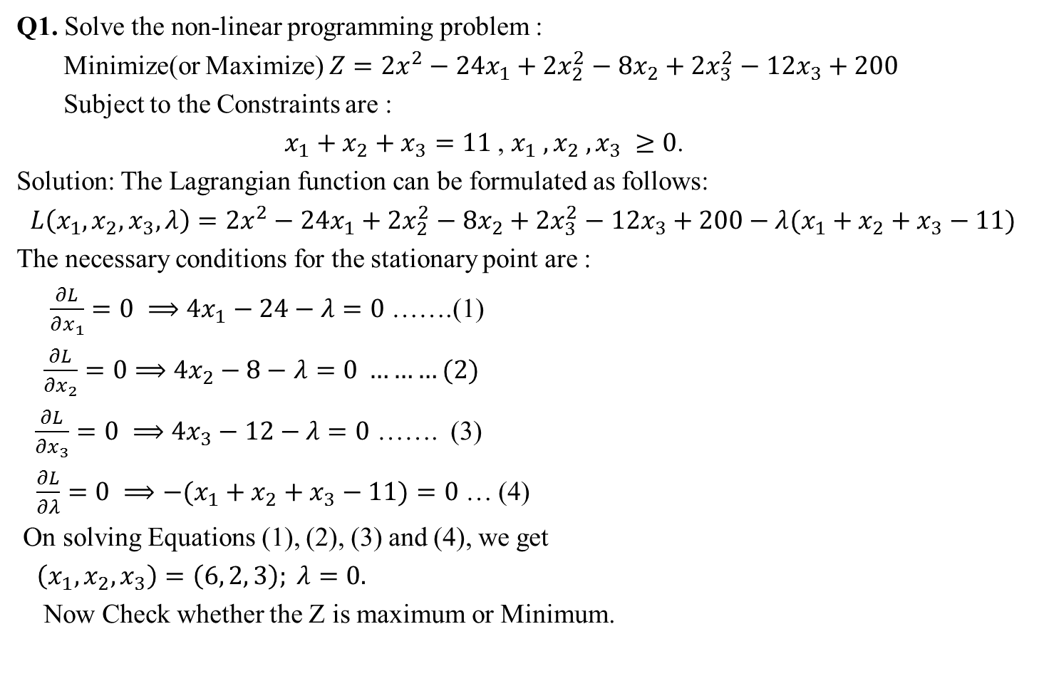
Examples of Lagrangian Method(CO3)
Q1. Solve the non-linear programming problem :
Minimize(or Maximize) $Z=2x^{2}−24x_{1}+2x_{2}^{2}−8x_{2}+2x_{3}^{2}−12x_{3}+200$
Subject to the Constraints are :
$x_{1}+x_{2}+x_{3}=11$ , $x_{1} , x_{2} , x_{3} ≥0$.
Solution: The Lagrangian function can be formulated as follows:
$L\left(x_{1}, x_{2}, x_{3}, λ\right)=2x^{2}−24x_{1}+2x_{2}^{2}−8x_{2}+2x_{3}^{2}−12x_{3}+200−λ(x_{1}+x_{2}+x_{3}−11)$
The necessary conditions for the stationary point are :
$\frac{∂L}{∂x_{1}}=0 ⟹4x_{1}−24−$$λ=0$ …….(1)
$\frac{∂L}{∂x_{2}}=0⟹$$4x_{2}−8−$$λ=0 ………(2)$
$\frac{∂L}{∂x_{3}}=0 ⟹4x_{3}−12−$$λ=0$……. (3)
$\frac{∂L}{∂λ}=0 ⟹−(x_{1}+x_{2}+x_{3}−11)=0$… (4)
On solving Equations (1), (2), (3) and (4), we get
$\left(x_{1}, x_{2}, x_{3}\right)=\left(6, 2, 3\right); λ=0.$
Now Check whether the Z is maximum or Minimum.

Slide 33

Examples of Lagrangian Method(CO3)
We have $Δ_{3}=\left|\begin{aligned}0 1 1 \\ 1 4 0 \\ 1 0 4\end{aligned}\right|=−8$ and $Δ_{4}=\left|\begin{aligned}0 1 1 1 \\ 1 4 0 0 \\ 1 0 4 0 \\ 1 0 0 4\end{aligned}\right|=−48$
Hence The given NLPP, the Z is minimum .

Slide 34

Daily Quiz
Q1. Examine whether the given non-linear programming is maximum or Minimum type:
Objective function $Z=6x_{1}x_{2}$
Subject to the constraints $2x_{1}+x_{2}=10$
$x_{1}, x_{2}≥0.$
Q2. Solve the following NLPP
$Z=6x_{1}x_{2}−10x_{3}$
Subject to the constraints $3x_{1}+x_{2}+3x_{3}=10.$
$x_{1}, x_{2}, x_{3}≥0.$

Slide 35
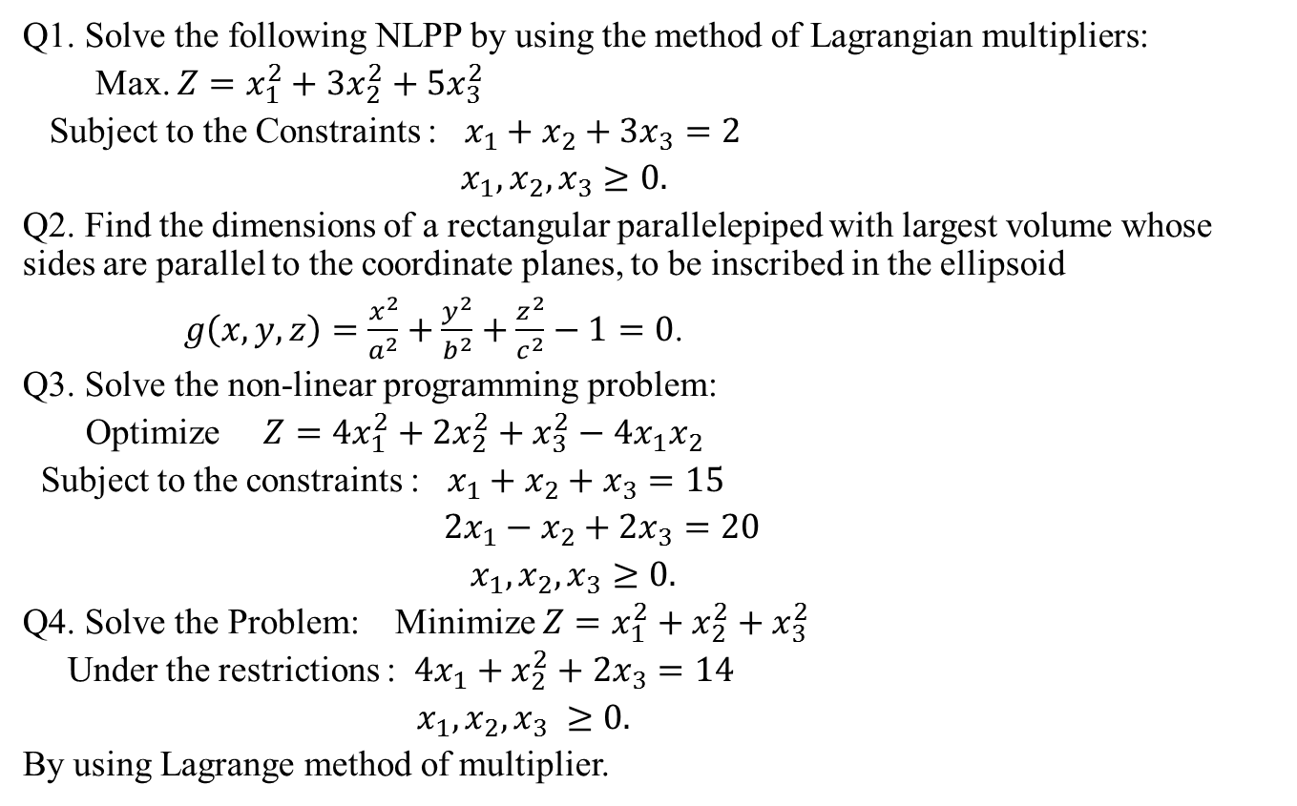
Weekly Assignment(CO3)
Q1. Solve the following NLPP by using the method of Lagrangian multipliers:
Max. $Z=x_{1}^{2}+3x_{2}^{2}+5x_{3}^{2}$
Subject to the Constraints : $x_{1}+x_{2}+3x_{3}=2$
$x_{1}, x_{2}, x_{3}≥0.$
Q2. Find the dimensions of a rectangular parallelepiped with largest volume whose sides are parallel to the coordinate planes, to be inscribed in the ellipsoid
$g\left(x,y,z\right)=\frac{x^{2}}{a^{2}}+\frac{y^{2}}{b^{2}}+\frac{z^{2}}{c^{2}}−1=0$.
Q3. Solve the non-linear programming problem:
Optimize $Z=4x_{1}^{2}+2x_{2}^{2}+x_{3}^{2}−4x_{1}x_{2}$
Subject to the constraints : $x_{1}+x_{2}+x_{3}=15$
$2x_{1}−x_{2}+2x_{3}=20$
$x_{1},x_{2},x_{3}≥0.$
Q4. Solve the Problem: Minimize $Z=x_{1}^{2}+x_{2}^{2}+x_{3}^{2}$
Under the restrictions : $4x_{1}+x_{2}^{2}+2x_{3}=14$
$x_{1}, x_{2}, x_{3} ≥0.$
By using Lagrange method of multiplier.

Slide 36
Prerequisite and Recap(CO3)
Knowledge of Mathematics-I of B.Tech.
Knowledge of Mathematics-II of B.Tech.
Knowledge of Maxima and Minima of a function of more than one variable.
Knowledge of Lagrange Method of Multiplier.

Slide 37
Topic Objective(CO3)
Constraints Problems of Maxima & Minima using Kuhn-Tucker Method:
In this Lecture, We discuss the problem of optimization of NLPP when the side conditions or constraints are in the form of inequalities.
We find the solution of the given NLPP by using Kuhn-Tucker Method.

Slide 38
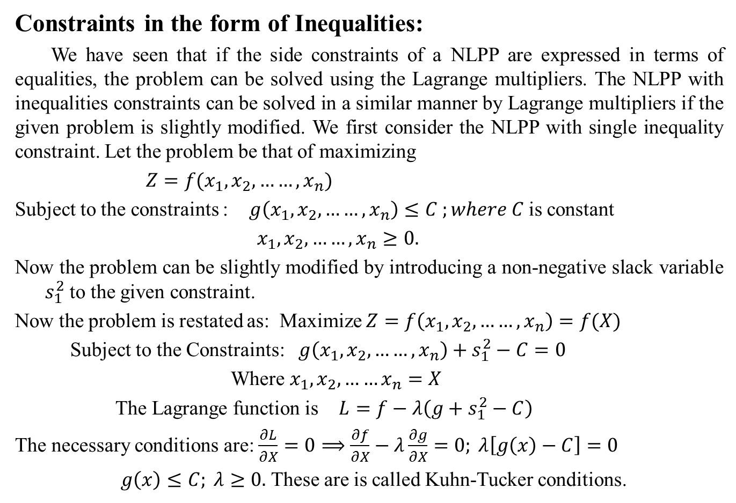
Kuhn-Tucker Conditions for Maximization(CO3)
Constraints in the form of Inequalities:
We have seen that if the side constraints of a NLPP are expressed in terms of equalities, the problem can be solved using the Lagrange multipliers. The NLPP with inequalities constraints can be solved in a similar manner by Lagrange multipliers if the given problem is slightly modified. We first consider the NLPP with single inequality constraint. Let the problem be that of maximizing
$Z=f(x_{1}, x_{2}, ……,x_{n})$
Subject to the constraints : $g\left(x_{1},x_{2}, ……,x_{n}\right)≤C ;where C$ is constant
$x_{1},x_{2},……,x_{n}≥0.$
Now the problem can be slightly modified by introducing a non-negative slack variable $s_{1}^{2}$ to the given constraint.
Now the problem is restated as: Maximize $Z=f\left(x_{1}, x_{2}, ……,x_{n}\right)=f(X)$
Subject to the Constraints: $g\left(x_{1},x_{2}, ……,x_{n}\right)+s_{1}^{2}−C=0$
Where $x_{1},x_{2},……x_{n}=X$
The Lagrange function is $L=f−λ\left(g+s_{1}^{2}−C\right)$
The necessary conditions are: $\frac{∂L}{∂X}=0⟹\frac{∂f}{∂X}−λ\frac{∂g}{∂X}=0; λ\left[g\left(x\right)−C\right]=0$
$g\left(x\right)≤C; λ≥0.$ These are is called Kuhn-Tucker conditions.

Slide 39
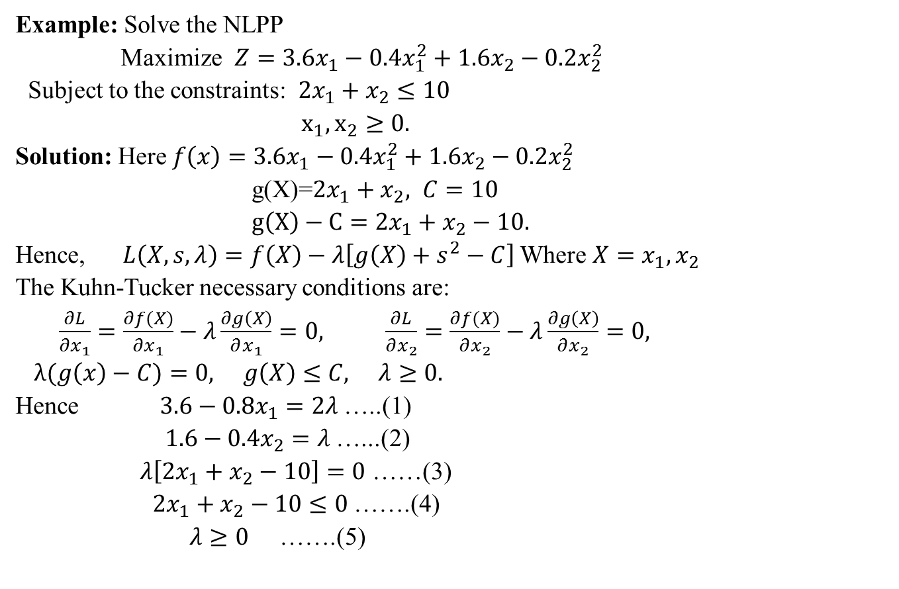
Numerical on Kuhn-Tucker(CO3)
Example: Solve the NLPP
Maximize $Z=3.6x_{1}−0.4x_{1}^{2}+1.6x_{2}−0.2x_{2}^{2}$
Subject to the constraints: $2x_{1}+x_{2}≤10$
$x_{1},x_{2}≥0.$
Solution: Here $f\left(x\right)=3.6x_{1}−0.4x_{1}^{2}+1.6x_{2}−0.2x_{2}^{2}$
g(X)=$2x_{1}+x_{2}, C=10$
$g\left(X\right)−C=2x_{1}+x_{2}−10.$
Hence, $L\left(X,s,λ\right)=f\left(X\right)−λ\left[g\left(X\right)+s^{2}−C\right]$ Where $X=x_{1},x_{2}$
The Kuhn-Tucker necessary conditions are:
$\frac{∂L}{∂x_{1}}=\frac{∂f(X)}{∂x_{1}}−λ\frac{∂g\left(X\right)}{∂x_{1}}=0, \frac{∂L}{∂x_{2}}=\frac{∂f(X)}{∂x_{2}}−λ\frac{∂g\left(X\right)}{∂x_{2}}=0,$
$λ(g\left(x\right)−C)=0, g\left(X\right)≤C, λ≥0.$
Hence $3.6−0.8x_{1}=2λ$…..(1)
$1.6−0.4x_{2}=λ$ …...(2)
$λ\left[2x_{1}+x_{2}−10\right]=0$ ……(3)
$2x_{1}+x_{2}−10≤0$ …….(4)
$λ≥0$ …….(5)

Slide 40

(CO3)
On solving equations (1),(2) and (3); we get
$x_{1}=3.5, x_{2}=3,λ=0.4\left(λ≠0\right).$
Now it easy to verify from (4) that $g(X)≤10$.
Hence $f(X)$ is concave and $g(X)$ is convex are the sufficient conditions for the maximum. Therefor the stationary point is $\left(3.5, 3\right).$
Now the maximum value of $Z=10.7$ .
*************

Slide 41
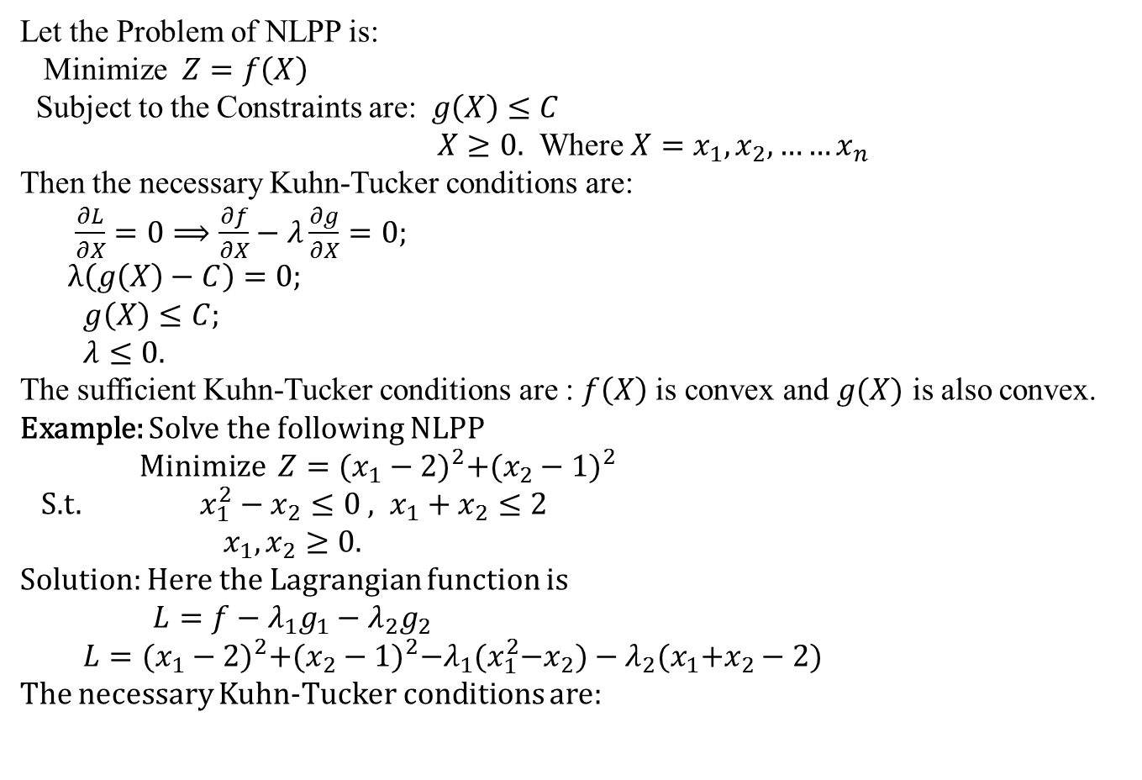
Kuhn-Tucker conditions for Minimization(CO3)
Let the Problem of NLPP is:
Minimize $Z=f\left(X\right)$
Subject to the Constraints are: $g\left(X\right)≤C$
$X≥0.$ Where $X=x_{1},x_{2}, ……x_{n}$
Then the necessary Kuhn-Tucker conditions are:
$\frac{∂L}{∂X}=0⟹\frac{∂f}{∂X}−λ\frac{∂g}{∂X}=0;$
$λ\left(g\left(X\right)−C\right)=0;$
$g\left(X\right)≤C;$
$λ≤0.$
The sufficient Kuhn-Tucker conditions are : $f\left(X\right)$ is convex and $g(X)$ is also convex.
Example: Solve the following NLPP
Minimize $Z={(x_{1}−2)}^{2}+{(x_{2}−1)}^{2}$
S.t.$x_{1}^{2}−x_{2}≤0 , x_{1}+x_{2}≤2$
$x_{1},x_{2}≥0.$
Solution: Here the Lagrangian function is
$L=f−λ_{1}g_{1}−λ_{2}g_{2}$
$L={(x_{1}−2)}^{2}+{(x_{2}−1)}^{2}−λ_{1}{(x}_{1}^{2}−x_{2})−λ_{2}{(x}_{1}+x_{2}−2)$
The necessary Kuhn-Tucker conditions are:

Slide 42
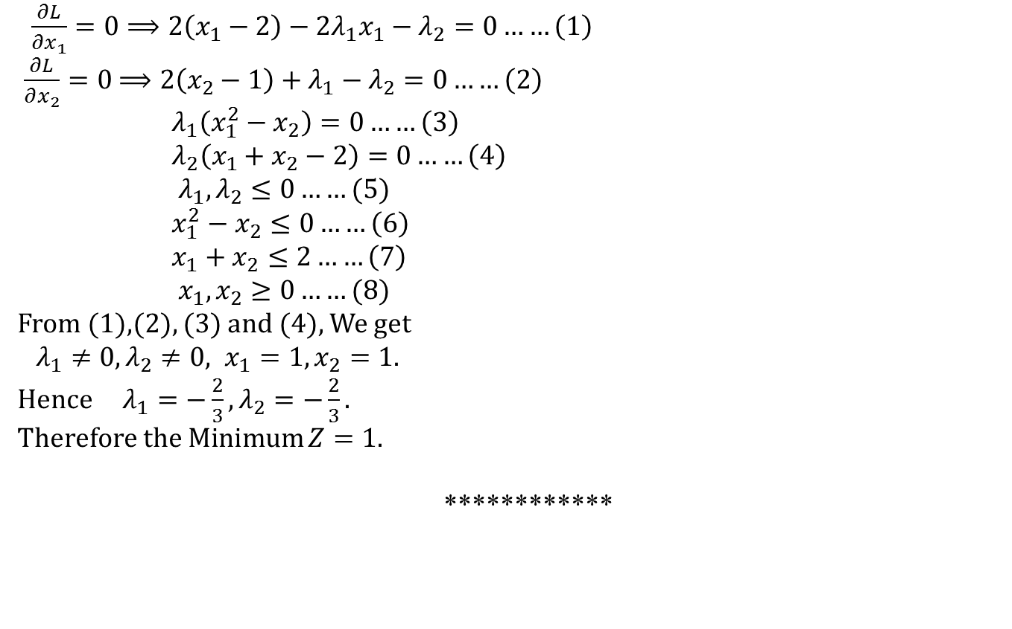
(CO3)
$\frac{∂L}{∂x_{1}}=0⟹2\left(x_{1}−2\right)−2λ_{1}x_{1}−λ_{2}=0……\left(1\right)$
$\frac{∂L}{∂x_{2}}=0$$⟹2\left(x_{2}−1\right)+λ_{1}−λ_{2}=0……\left(2\right)$
$λ_{1}\left(x_{1}^{2}−x_{2}\right)=0……\left(3\right)$
$λ_{2}\left(x_{1}+x_{2}−2\right)=0……\left(4\right)$
$λ_{1},λ_{2}≤0……(5)$
$x_{1}^{2}−x_{2}≤0……\left(6\right)$
$x_{1}+x_{2}≤2……\left(7\right)$
$x_{1},x_{2}≥0……(8)$
From (1),(2), (3) and (4), We get
$λ_{1}≠0, λ_{2}≠0, x_{1}=1, x_{2}=1.$
Hence $λ_{1}=−\frac{2}{3}, λ_{2}=−\frac{2}{3}.$
Therefore the Minimum $Z=1.$
************

Slide 43

Daily Quiz(CO3)
Q1. Solve the NLPP
Max. $Z=2x_{1}^{2}+12x_{1}x_{2}−7x_{2}^{2}$
S.t.$2x_{1}+5x_{2}≤98$
$x_{1},x_{2}≥0.$
Q2. Solve the NLPP
Max. $Z=2x_{1}−x_{1}^{2}+x_{2}$
Subject to the constraints: $2x_{1}+3x_{2}≤6$
$2x_{1}+x_{2}≤4$
$x_{1},x_{2}≥0.$
***********

Slide 44
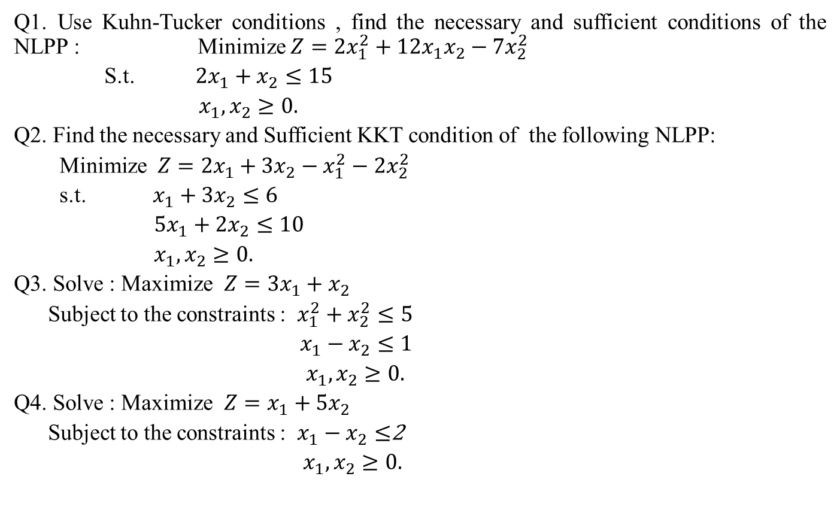
Weekly Assignment(CO3)
Q1. Use Kuhn-Tucker conditions , find the necessary and sufficient conditions of the NLPP : Minimize $Z=2x_{1}^{2}+12x_{1}x_{2}−7x_{2}^{2}$
S.t.$2x_{1}+x_{2}≤15$
$x_{1},x_{2}≥0.$
Q2. Find the necessary and Sufficient KKT condition of the following NLPP:
Minimize $Z=2x_{1}+3x_{2}−x_{1}^{2}−2x_{2}^{2}$
s.t.$x_{1}+3x_{2}≤6$
$5x_{1}+2x_{2}≤10$
$x_{1},x_{2}≥0.$
Q3. Solve : Maximize $Z=3x_{1}+x_{2}$
Subject to the constraints : $x_{1}^{2}+x_{2}^{2}≤5$
$x_{1}−x_{2}≤1$
$x_{1},x_{2}≥0.$
Q4. Solve : Maximize $Z=x_{1}+{5x}_{2}$
Subject to the constraints : $x_{1}−x_{2}≤$2
$x_{1},x_{2}≥0.$

Slide 45
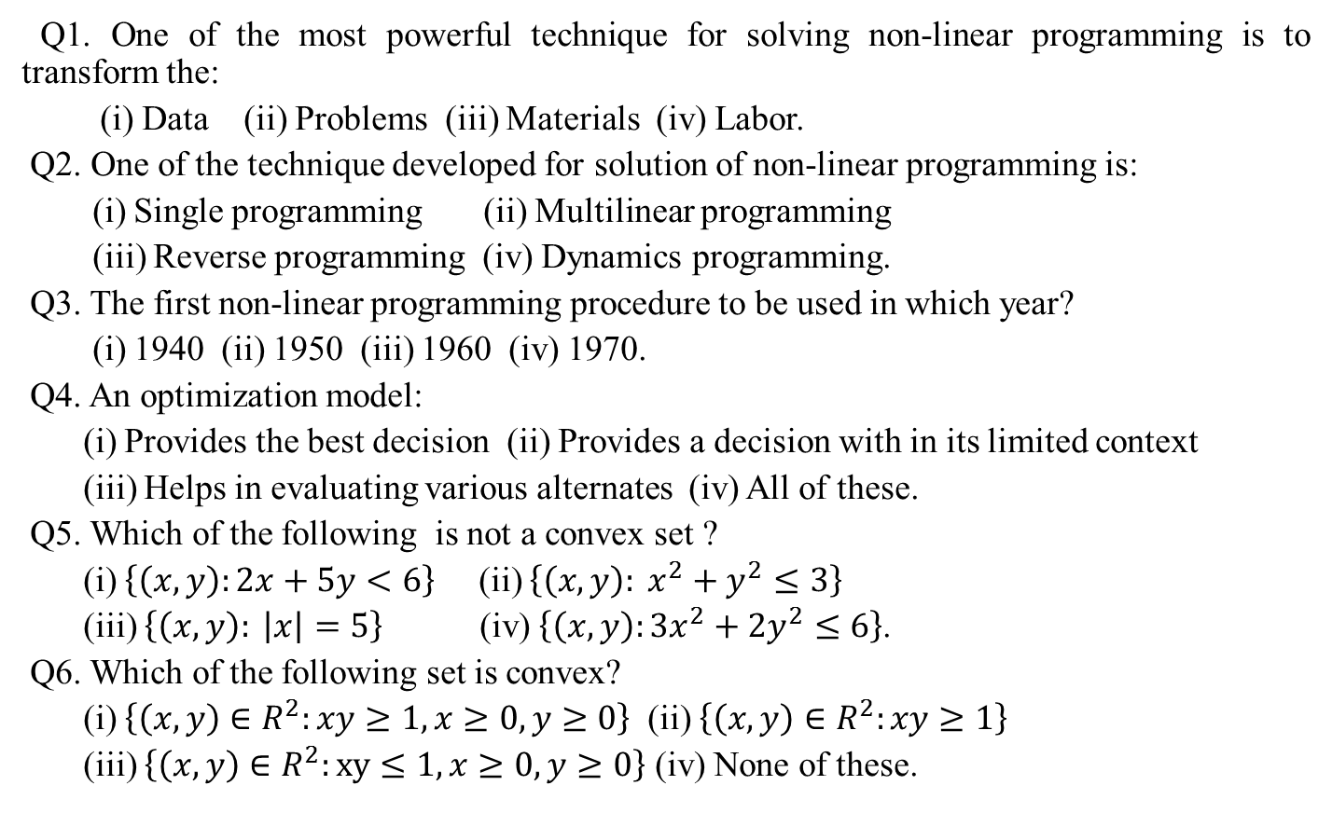
ALIIGATION & MIXTURE
Multiple Choice Questions(CO3)
Q1. One of the most powerful technique for solving non-linear programming is to transform the:
(i) Data (ii) Problems (iii) Materials (iv) Labor.
Q2. One of the technique developed for solution of non-linear programming is:
(i) Single programming (ii) Multilinear programming
(iii) Reverse programming (iv) Dynamics programming.
Q3. The first non-linear programming procedure to be used in which year?
(i) 1940 (ii) 1950 (iii) 1960 (iv) 1970.
Q4. An optimization model:
(i) Provides the best decision (ii) Provides a decision with in its limited context
(iii) Helps in evaluating various alternates (iv) All of these.
Q5. Which of the following is not a convex set ?
(i) $\left\{\left(x,y\right):2x+5y<6\right\}$ (ii) $\left\{\left(x,y\right): x^{2}+y^{2}≤3\right\}$
(iii) $\left\{\left(x,y\right): \left|x\right|=5\right\}$ (iv) $\left\{\left(x,y\right):3x^{2}+2y^{2}≤6\right\}$.
Q6. Which of the following set is convex?
(i) $\left\{\left(x,y\right)∈R^{2}:xy≥1,x≥0,y≥0\right\}$ (ii) $\left\{\left(x,y\right)∈R^{2}:xy≥1\right\}$
(iii) $\left\{\left(x,y\right)∈R^{2}:xy≤1,x≥0,y≥0\right\}$ (iv) None of these.

Slide 46
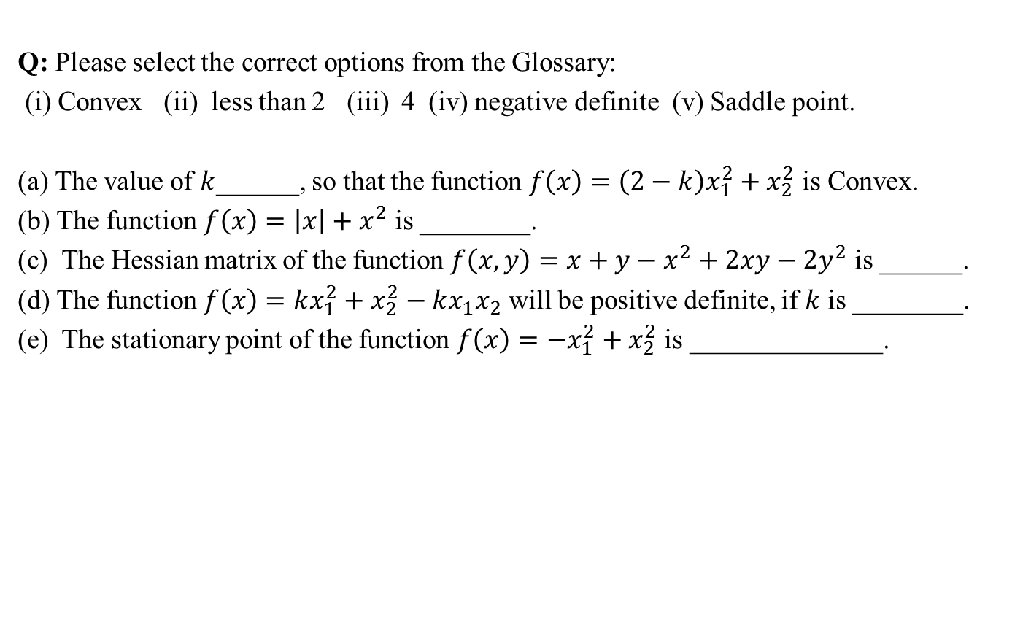
ALIIGATION & MIXTURE
Glossary Questions(CO3)
Q: Please select the correct options from the Glossary:
(i) Convex (ii) less than 2 (iii) 4 (iv) negative definite (v) Saddle point.
(a) The value of $k$______, so that the function $f\left(x\right)=\left(2−k\right)x_{1}^{2}+x_{2}^{2}$ is Convex.
(b) The function $f\left(x\right)=\left|x\right|+x^{2}$ is ________.
(c) The Hessian matrix of the function $f\left(x,y\right)=x+y−x^{2}+2xy−2y^{2}$ is ______.
(d) The function $f\left(x\right)=kx_{1}^{2}+x_{2}^{2}−kx_{1}x_{2}$ will be positive definite, if $k$ is ________.
(e) The stationary point of the function $f\left(x\right)=−x_{1}^{2}+x_{2}^{2}$ is ______________.

Slide 47
ALIIGATION & MIXTURE
Faculty Video Links, YouTube Links (CO3)
https://youtu.be/jGwA4hknYp4
https://youtu.be/ejol5TMpYJc
https://youtu.be/tJfizPGPo34
https://youtu.be/nZ40jnChzbs
https://youtu.be/PlpJShHvNfQ

Slide 48
Old Question Paper(CO3)

Slide 49
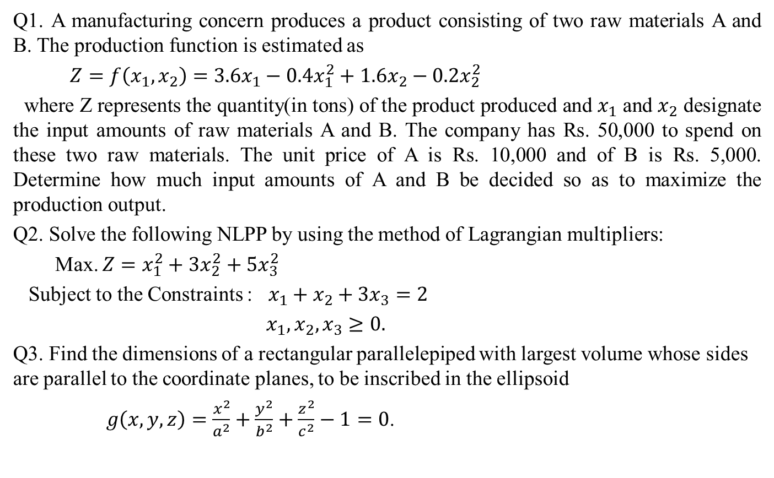
Assignment - 1
Expected Questions for University Exam(CO3)
Q1. A manufacturing concern produces a product consisting of two raw materials A and B. The production function is estimated as
$Z=f\left(x_{1},x_{2}\right)=3.6x_{1}−0.4x_{1}^{2}+1.6x_{2}−0.2x_{2}^{2}$
where Z represents the quantity(in tons) of the product produced and $x_{1}$ and $x_{2}$ designate the input amounts of raw materials A and B. The company has Rs. 50,000 to spend on these two raw materials. The unit price of A is Rs. 10,000 and of B is Rs. 5,000. Determine how much input amounts of A and B be decided so as to maximize the production output.
Q2. Solve the following NLPP by using the method of Lagrangian multipliers:
Max. $Z=x_{1}^{2}+3x_{2}^{2}+5x_{3}^{2}$
Subject to the Constraints : $x_{1}+x_{2}+3x_{3}=2$
$x_{1}, x_{2}, x_{3}≥0.$
Q3. Find the dimensions of a rectangular parallelepiped with largest volume whose sides are parallel to the coordinate planes, to be inscribed in the ellipsoid
$g\left(x,y,z\right)=\frac{x^{2}}{a^{2}}+\frac{y^{2}}{b^{2}}+\frac{z^{2}}{c^{2}}−1=0$.

Slide 50
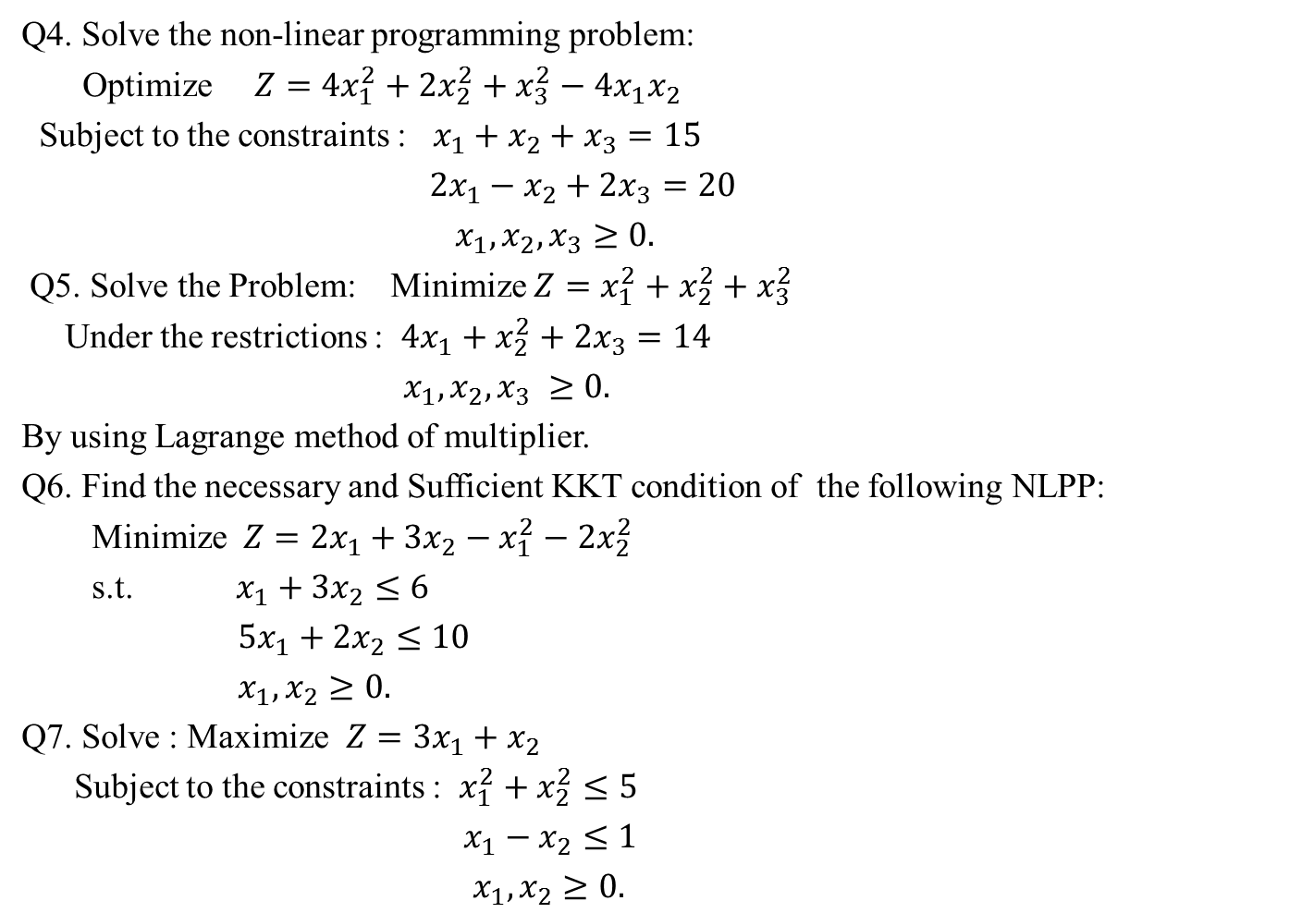
Assignment - 1
Expected Questions for University Exam(CO3)
Q4. Solve the non-linear programming problem:
Optimize $Z=4x_{1}^{2}+2x_{2}^{2}+x_{3}^{2}−4x_{1}x_{2}$
Subject to the constraints : $x_{1}+x_{2}+x_{3}=15$
$2x_{1}−x_{2}+2x_{3}=20$
$x_{1},x_{2},x_{3}≥0.$
Q5. Solve the Problem: Minimize $Z=x_{1}^{2}+x_{2}^{2}+x_{3}^{2}$
Under the restrictions : $4x_{1}+x_{2}^{2}+2x_{3}=14$
$x_{1}, x_{2}, x_{3} ≥0.$
By using Lagrange method of multiplier.
Q6. Find the necessary and Sufficient KKT condition of the following NLPP:
Minimize $Z=2x_{1}+3x_{2}−x_{1}^{2}−2x_{2}^{2}$
s.t.$x_{1}+3x_{2}≤6$
$5x_{1}+2x_{2}≤10$
$x_{1},x_{2}≥0.$
Q7. Solve : Maximize $Z=3x_{1}+x_{2}$
Subject to the constraints : $x_{1}^{2}+x_{2}^{2}≤5$
$x_{1}−x_{2}≤1$
$x_{1},x_{2}≥0.$

Slide 51
Recap of Unit-III(CO3)
The Optimization theory deals with the use of differential calculus to determine the points of maxima and minima for both unconstraint and constraints continuous functions.
In this unit the treatment of the constraints problems of non-linear programming problems using the Lagrange method of multiplier and development of Kuhn-Tucker conditions for the general problem with equality and inequality constraints.

Slide 52
Noida Institute of Engineering and Technology, Greater Noida
Text Books
Sharma J.K.- “operation Research” ( Pearson, 3rd Edition)
Rao S.S.- “ Optimization theory and Application”, (Wiley Easter Ltd.)
Taha Hamdy A.- “Operation Research- An Introduction”(Prentice-Hall)

Slide 53
Noida Institute of Engineering and Technology, Greater Noida
Reference Books
An introduction to Optimization by Edwin P K Chong, Stainlaw Zak.
David G. Luerbeggan, “ Introduction to linear and non-linear Programming”, (Addison Wesley Publishing Co.)

Slide 54
(CO3)
Thank You

